Slide 1
COMS 4111: Introduction to Databases Lecture 19: Database Applications (I), Transactions (I)
Dr. Donald F. Ferguson
dff9@columbia.edu

Slide 2
Comments Questions

Slide 3
Schedule
21-Nov:
Transactions (I), Database applications (I)
Written HW 4 published, extra credit 2 published.
23-Nov: No class; Thanksgiving
28-Nov: Transactions (II), Database applications (II)
30-Nov:
CAP Theorem, NoSQL DB (I), Neo4J
HW 4 due, HW 5 assigned, Extra credit 2 due
05-Dec:
Final exam published
No SQL DB (II), Redis
07-Dec: Review, final exam Q&A
11-Dec: HW 5 due
19-Dec 12:00:00:
Final exam due and submitted on CourseWorks
No late/grace days or extensions.

Slide 4
Introduction to Database Applications

Slide 5
What is happening?
A Data Definition Statement Defines or “Creates” a definition/type of data, which is needed for DML.
“Client” App 1
Connection
DDL Statement
“Client” App 2
Database
Management
System
(Instance)
“Client” App …
DML Statement
A Data Manipulation Statement Creates, Retrieves, Updates or Deletes Data.

Slide 6
One Classification of Database Applications (https://www.fedena.com/blog/2015/12/understanding-types-of-database-software-and-their-applications.html)
Operational Database
External Database
End User Database
Distributed Database
Data Warehouse Database
Analytical Database
Hypermedia Database

Slide 7
Another Classification (https://www.quickbase.com/articles/database-software-basics)
Analytical database software allows the user to pull data from a variety of databases and examine them for the purpose of quantitatively assessing performance (business, departmental, employee, etc.).
Data warehouse software allows the user to pull key data from a variety of databases and store it in a central location for the purpose of deriving critical insights and reporting those insights. Data warehousing helps to ensure data integrity by readily identifying inconsistencies.
Distributed database software involves a centralized database management system that controls information stored in a variety of locations (including the cloud, a company LAN or a network server). The distributed model is often considered the safest because of its natural data redundancy.
End user database software stores information that is used primarily by one person (Microsoft Excel and its spreadsheets are an example).
External database software compiles information that must be accessed by a variety of users, often via the Internet.
Operational database software allows the user to modify data in real-time (for purposes such as financial and customer relationship management)

Slide 8
Another Classification (https://www.quickbase.com/articles/database-software-basics)
Analytical database software allows the user to pull data from a variety of databases and examine them for the purpose of quantitatively assessing performance (business, departmental, employee, etc.).
Data warehouse software allows the user to pull key data from a variety of databases and store it in a central location for the purpose of deriving critical insights and reporting those insights. Data warehousing helps to ensure data integrity by readily identifying inconsistencies.
Distributed database software involves a centralized database management system that controls information stored in a variety of locations (including the cloud, a company LAN or a network server). The distributed model is often considered the safest because of its natural data redundancy.
End user database software stores information that is used primarily by one person (Microsoft Excel and its spreadsheets are an example).
External database software compiles information that must be accessed by a variety of users, often via the Internet.
Operational database software allows the user to modify data in real-time (for purposes such as financial and customer relationship management)
Initial examples will be in these categories.

Slide 9

Web Application (Demo)

Slide 10
Web/Internet Application
Accounts
Products
User profiles
Registrations
Course schedule
etc.
Machine D – Database Server
Devices
Other Corporations’ Apps
HTML JPG, MPG JavaScript CSS etc.
There are 100s, 1000s, millions of simultaneous user sessions.
There may be 100s, 1000s of servers at each tier to achieve
Scalability (throughput, response time)
Availability, fault tolerance.
Servers may be spread over multiple data centers, public/private clouds, etc.

Slide 11
More Complex, but Simple Cloud Example

Slide 12
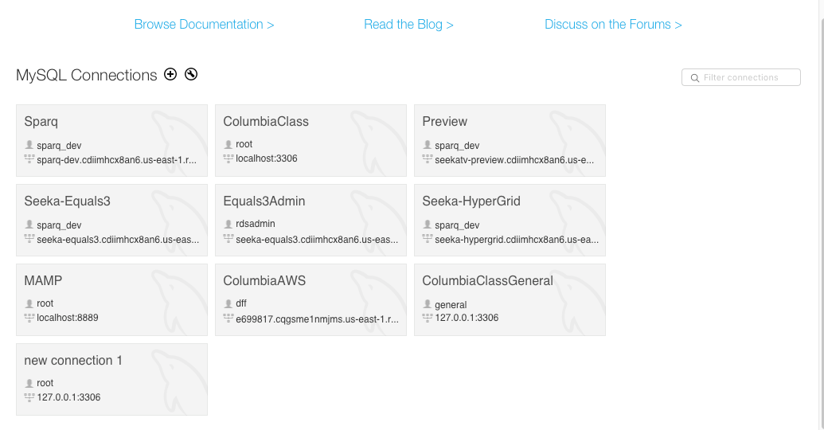
Multiple Databases

Slide 13
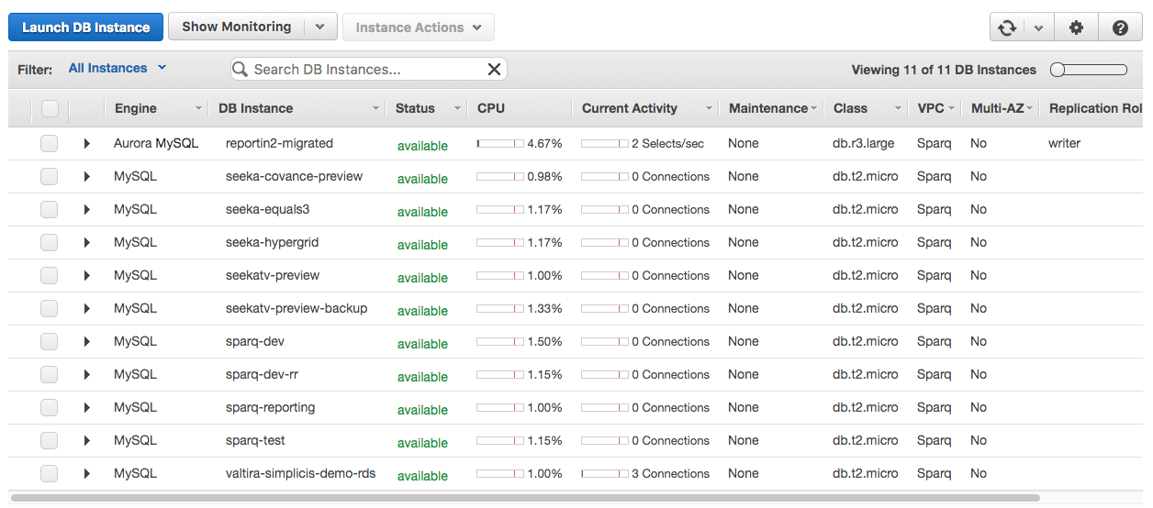
Multiple Databases

Slide 14
Concurrent Execution

Slide 15
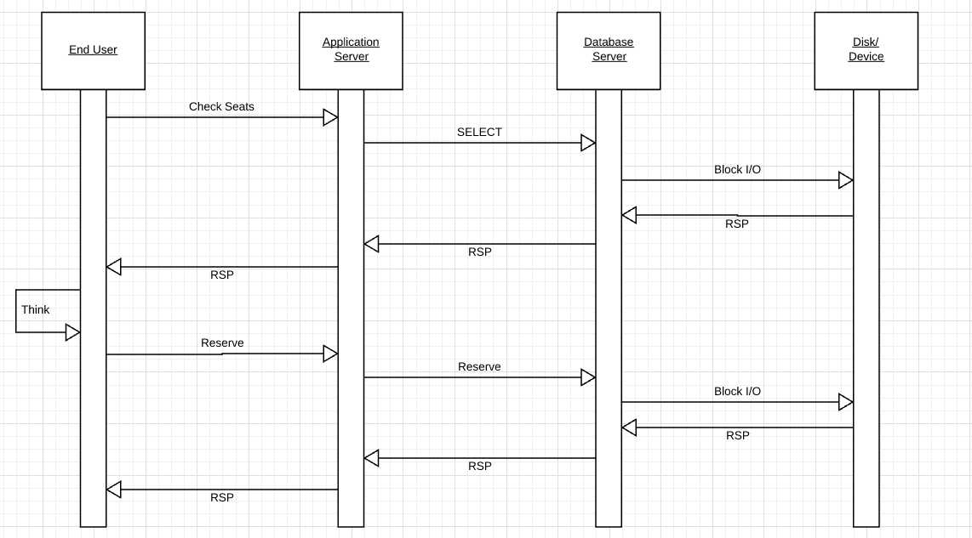
Typical Interaction Operation Choose a Seat

Slide 16
Typical Interaction Operation Choose a Seat
What does the DB server CPU do while waiting? Remember, I/O takes forever from a CPUs perspective.
What happens while the user thinks, which is eons for a CPU? Can anyone else book seats?

Slide 17
Some Terms
“In computing, multitasking is a concept of performing multiple tasks (also known as processes) over a certain period of time by executing them concurrently. New tasks start and interrupt already started ones before they have reached completion, instead of executing the tasks sequentially so each started task needs to reach its end before a new one is started. As a result, a computer executes segments of multiple tasks in an interleaved manner, while the tasks share common processing resources such as central processing units (CPUs) and main memory.”
“In multiprogramming systems, the running task keeps running until it performs an operation that requires waiting for an external event (e.g. reading from a disk or tape, receiving a message from a network, reading from a terminal or other human input device) or until the computer's scheduler forcibly swaps the running task out of the CPU. Multiprogramming systems are designed to maximize CPU usage.”
“Multithreading
As multitasking greatly improved the throughput of computers, programmers started to implement applications as sets of cooperating processes (e. g., one process gathering input data, one process processing input data, one process writing out results on disk). This, however, required some tools to allow processes to efficiently exchange data.^{[citation needed]}
Threads were born from the idea that the most efficient way for cooperating processes to exchange data would be to share their entire memory space. Thus, threads are effectively processes that run in the same memory context and share other resources with their parent processes, such as open files. Threads are described as lightweight processes because switching between threads does not involve changing the memory context.”

Slide 18
Some Terms
“In computing, multitasking is a concept of performing multiple tasks (also known as processes) over a certain period of time by executing them concurrently. New tasks start and interrupt already started ones before they have reached completion, instead of executing the tasks sequentially so each started task needs to reach its end before a new one is started. As a result, a computer executes segments of multiple tasks in an interleaved manner, while the tasks share common processing resources such as central processing units (CPUs) and main memory.”
“In multiprogramming systems, the running task keeps running until it performs an operation that requires waiting for an external event (e.g. reading from a disk or tape, receiving a message from a network, reading from a terminal or other human input device) or until the computer's scheduler forcibly swaps the running task out of the CPU. Multiprogramming systems are designed to maximize CPU usage.”
“Multithreading
As multitasking greatly improved the throughput of computers, programmers started to implement applications as sets of cooperating processes (e. g., one process gathering input data, one process processing input data, one process writing out results on disk). This, however, required some tools to allow processes to efficiently exchange data.^{[citation needed]}
Threads were born from the idea that the most efficient way for cooperating processes to exchange data would be to share their entire memory space. Thus, threads are effectively processes that run in the same memory context and share other resources with their parent processes, such as open files. Threads are described as lightweight processes because switching between threads does not involve changing the memory context.”
Overly simplistically,
The database server is an operating system process, and competes with other processes for CPU, memory, etc.
The database server is internally multithreaded and processes multiple query operations, swapping between threads when there is a buffer miss (block I/O required).

Slide 19
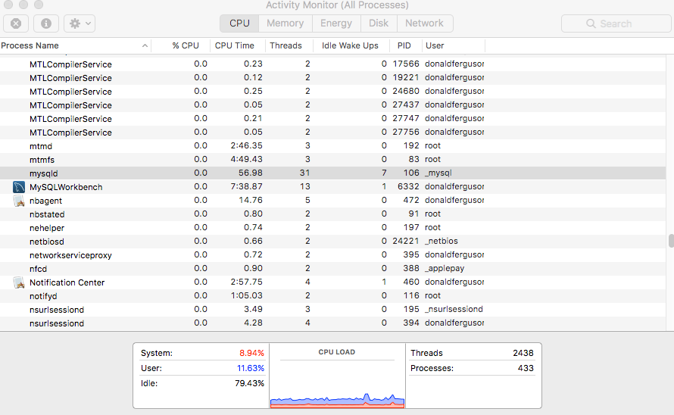
An Example
Obviously, on a dedicated HW or virtual server
The database server does not compete for resources with
Word
Eclipse
Chrome
etc.
But, will compete with
Background OS tasks.
Security monitoring SW
Admin SW
etc.
Use internal multithreading, which is much more efficient than OS level process switching.

Slide 20
Some Simple Code

Slide 21
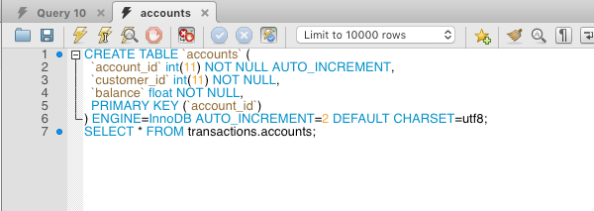
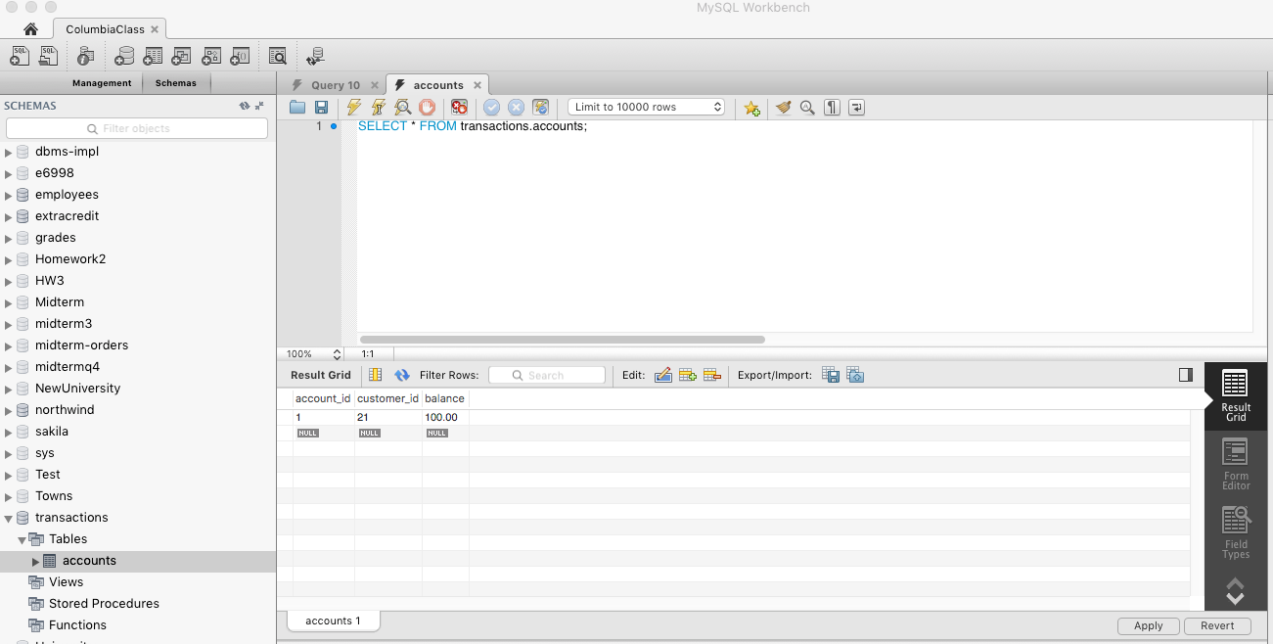
Data

Slide 22
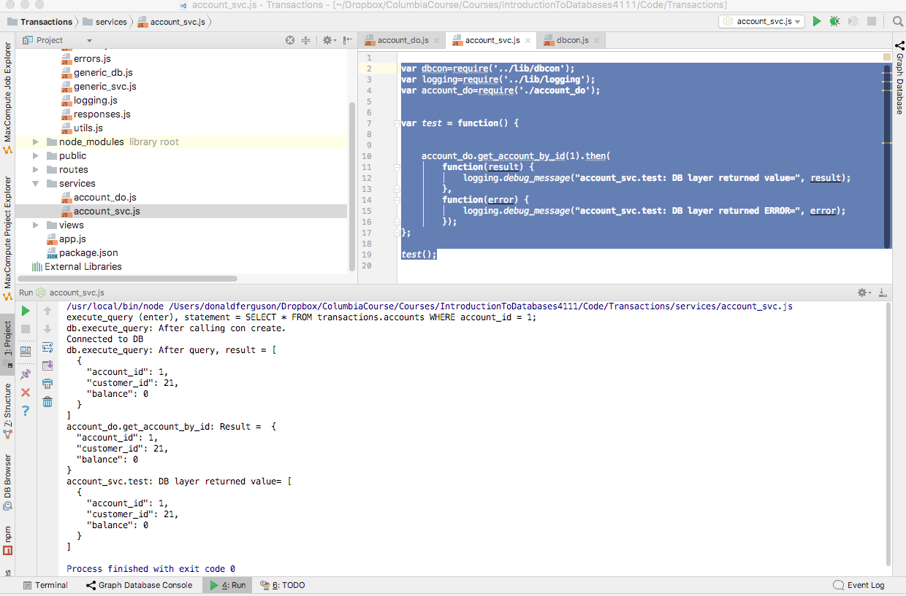
Execution

Slide 23
What is happening?
MySQL process running on my laptop, but could have been anywhere on the Internet.
“Client” App 1
Connection
DDL Statement
“Client” App 2
Database
Management
System
(Instance)
DML Statement
An integrated, development environment ran code that I wrote, which connected to DBMS instance and ran a query.

Slide 24
Some Simple Code: Account Data Object/SVC
var dbcon=require('../lib/dbcon'); var logging=require('../lib/logging'); var get_account_by_id = function(id) { return new Promise(function(resolve, reject) { var get_statement = "SELECT * FROM transactions.accounts WHERE account_id = " + id + ";"; dbcon.execute_query(get_statement,null).then( function(result) { logging.debug_message("account_do.get_account_by_id: Result = ", result[0]); resolve(result); }, function(error) { logging.error_message("account_do.get_account_by_id: ERROR = ", error); resolve(result); } ) }); };

Slide 25
Calling the Data Object/Service
var dbcon=require('../lib/dbcon'); var logging=require('../lib/logging'); var account_do=require('./account_do'); var test = function() { account_do.get_account_by_id(1).then( function(result) { logging.debug_message("account_svc.test: DB layer returned value=", result); }, function(error) { logging.debug_message("account_svc.test: DB layer returned ERROR=", error); }); }; test();

Slide 26
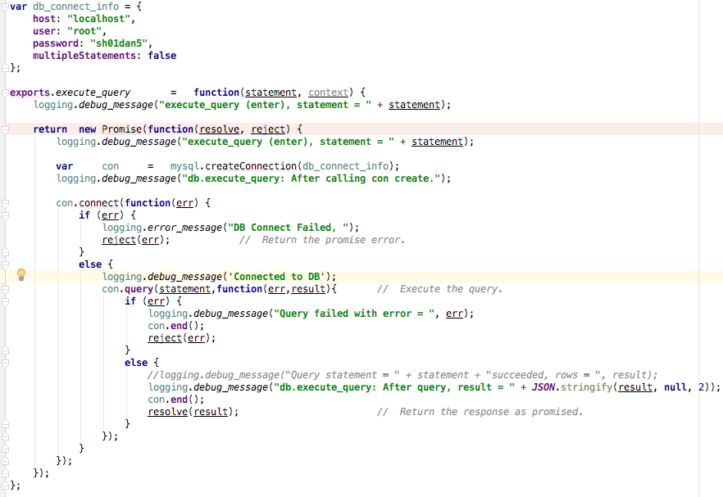
DB Connection

Slide 27
Database Connection
“In computer science, a database connection is the means by which a database server and its client software communicate with each other. The term is used whether or not the client and the server are on different machines. … … The client uses a database connection to send commands to and receive replies from the server.” (https://en.wikipedia.org/wiki/Database_connection)”
Database Management Systems provide client API libraries built on top of network protocols and standards. Application use the library to
Connect to a DB instance via IP address, port number, DB name.
Provide logon and configuration information.
Execute a series of SQL statements.
Signal that the interaction is done and close connection.

Slide 28
DB Connection ( modified from https://codeforgeek.com/2015/01/nodejs-mysql-tutorial/)
var mysql = require('mysql'); var connection = mysql.createConnection({ host : 'localhost', user : '< MySQL username >', password : '< MySQL password >', database : '<your database name>' }); connection.connect(); connection.query('SELECT * from < table name >', function(err, rows, fields) { if (!err) console.log('The solution is: ', rows); else console.log('Error while performing Query.'); });
connection.query(' Some other SQL Statememt', function(err, rows, fields) { // Handle the callback });
connection.query(' Some third SQL Statememt', function(err, rows, fields) { // Handle the callback });
connection.end();

Slide 29
Update an Account
var update_account_by_id = function(id, data) { return new Promise(function(resolve, reject) { var update_statement = "UPDATE transactions.accounts "; if (data.balance) { update_statement = update_statement + "SET balance=" + data.balance; if (data.customer_id) { update_statement = update_statement + ", customer_id=" + data.customer_id; } } else { if (data.customer_id) { update_statement = update_statement + "SET customer_id=" + data.customer_id; } else { logging.debug_message("account_do.update_account_by_id: ERROR. Nothing specified"); reject("Nothing to update"); return; } } update_statement = update_statement + " WHERE account_id=" + id + ";"; dbcon.execute_query(update_statement,null).then( function(result) { logging.debug_message("account_do.update_account_by_id: Result = ", result[0]); resolve(result); }, function(error) { logging.error_message("account_do.update_account_by_id: ERROR = ", error); resolve(result); } ) }); };

Slide 30
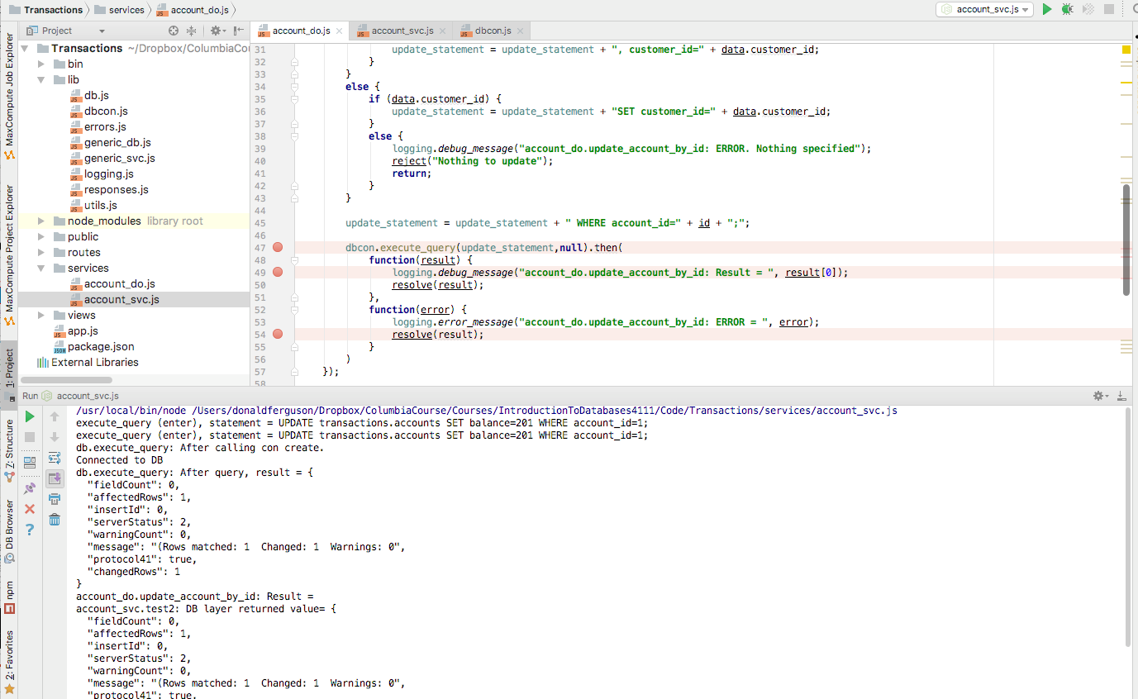
Execution

Slide 31
Consider Transfer

Slide 32
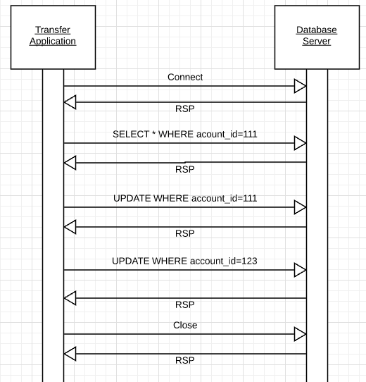
Transfer Funds
Transfer $50 from
account_id=111 to
account_id=123
Requires 3 SQL statements
SELECT from 111 to make sure there is more than $50.
UPDATE account_id=111
UPDATE account_id=123
There are some interesting scenarios
Two different programs read the balance ($51) and decide removing $50 is OK.
Something fails (client, server, network) after a program debits one account and before crediting the second account.
Multiple readers
Some failure happens

Slide 33
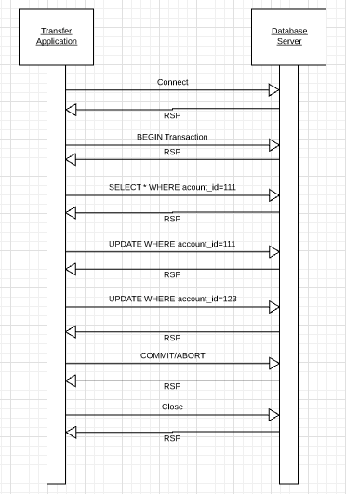
Transactions
Database Management Systems introduce two additional operations
BEGIN TRANSACTION
COMMIT/ABORT TRANSACTION
Transactions are
Atomic: All updates happen or none happen.
Consistent: Ensures that any transaction will bring the database from one valid state to another.
Isolation: Ensures that the concurrent execution of transactions results in a system state that would be obtained if transactions were executed sequentially, i.e., one after the other.
Durable: The durability property ensures that once a transaction has been committed, it will remain so, even in the event of power loss, crashes, or errors

Slide 34
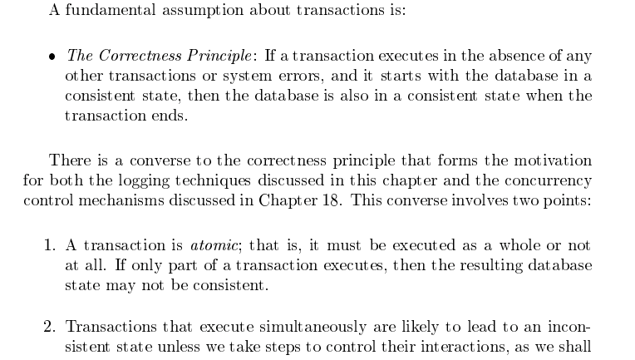
Garcia-Molina et al., p. 847

Slide 35
Atomicity of Transactions
A transaction might commit after completing all its actions, or it could abort (or be aborted by the DBMS) after executing some actions.
A very important property guaranteed by the DBMS for all transactions is that they are atomic. That is, a user can think of a Xact as always executing all its actions in one step, or not executing any actions at all.
A core enablement of atomicity and durability is logging.

Slide 36
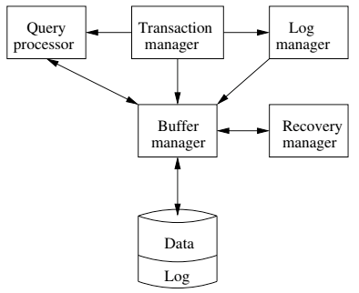
DBMS ACID Implementation
Implementation Subsystems
Query processor schedules and executes queries.
Buffer manager controls reading/writing blocks/frames to/from disk.
Log manager journals/records events to disk (log), e.g.
Transaction start/commit/abort
Transaction update of a block and previous value of data.
Transaction manager coordinates query scheduling, buffer read/write and logging to ensure ACID.
Recovery manager processes log to ensure ACID even after transaction or system failures.
Log is a special type of block file used by the system to optimize performance and ensure ACID.
Garcia-Molina et al., p. 846

